Slide 1

Industrial Training Seminar
on
“Web Development”
Presented By:
Name of Candidate-Rishi Vyas
University Roll No.-20EJCIT128
Branch/Class/Section-IT/5th Sem/C
Submitted To:
Ms.Kusum Yadav
Industrial Training Coordinator,IT

Slide 2
Contents
Introduction/Abstract
Company/Organization Details
Certificate
Technology Name
5. Overview of tools used
6. Project Description
7. Screenshots of Project
8. Conclusion
9. Future Scope
10.References

Slide 3
ABSTRACT
Web development is the work involved in developing a website for the Internet (World Wide Web) or an intranet (a private network).
Web development can range from developing a simple single static page of plain text to complex web applications, electronic businesses, and social network services
.
A more comprehensive list of tasks to which Web development commonly refers, may include Web design, Web content development, client-side/server-side scripting, Web server and network security configuration, and e-commerce development.

Slide 4
Among Web professionals, "Web development" usually refers to the main non-design aspects of building Web sites: writing markup and coding.
Web development may use content management systems (CMS) to make content changes easier and available with basic technical skills.
There are three kind of web developer specialization : front-end developer, back-end developer and full stack developer .

Slide 5
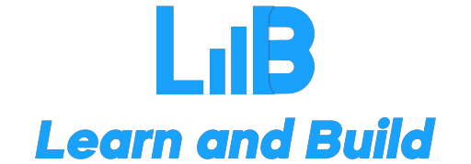
COMPANY DETAILS
Company Name
Company from which I attended the training is “Learn and Build”.
Learn and Build is an Indian Company. It was founded in 2016. Learn and Build (LnB), is a tech learning vertical by TechieNest Pvt. Ltd. Furthering our 10+ years of strong legacy and training over 200K candidates from 300+ premium institutions including IIT’s & NITs, LnB aims at making quality technical education accessible to learners across the country.
Domain Area
LnB works as the cornerstone for budding technocrats and stepping stone for working professionals, enabling India with technology creators. The courses it offers are Artificial Intelligence, Big Data, Cloud Computing, Data Science, DevOps, Microservices, Embedded Systems, Ethical Hacking, Machine Learning, Programming Languages, and Robotics.

Slide 6
Background of Company
Learn and Build was founded in 2016 in India. It has it’s headquarters in Jaipur. Learn and Build (LnB),is a tech learning vertical by TechieNest Pvt. Ltd. Furthering our 10+ years of strong legacy and training over 200K candidates from 300+ premium institutions including IIT’s & NITs, LnB aims at making quality technical education accessible to learners across the country.
Size of Company
As of Oct. 2022, the platform has between 201 to 500 employees ,teaching course in over many different languages across all over the world.

Slide 7
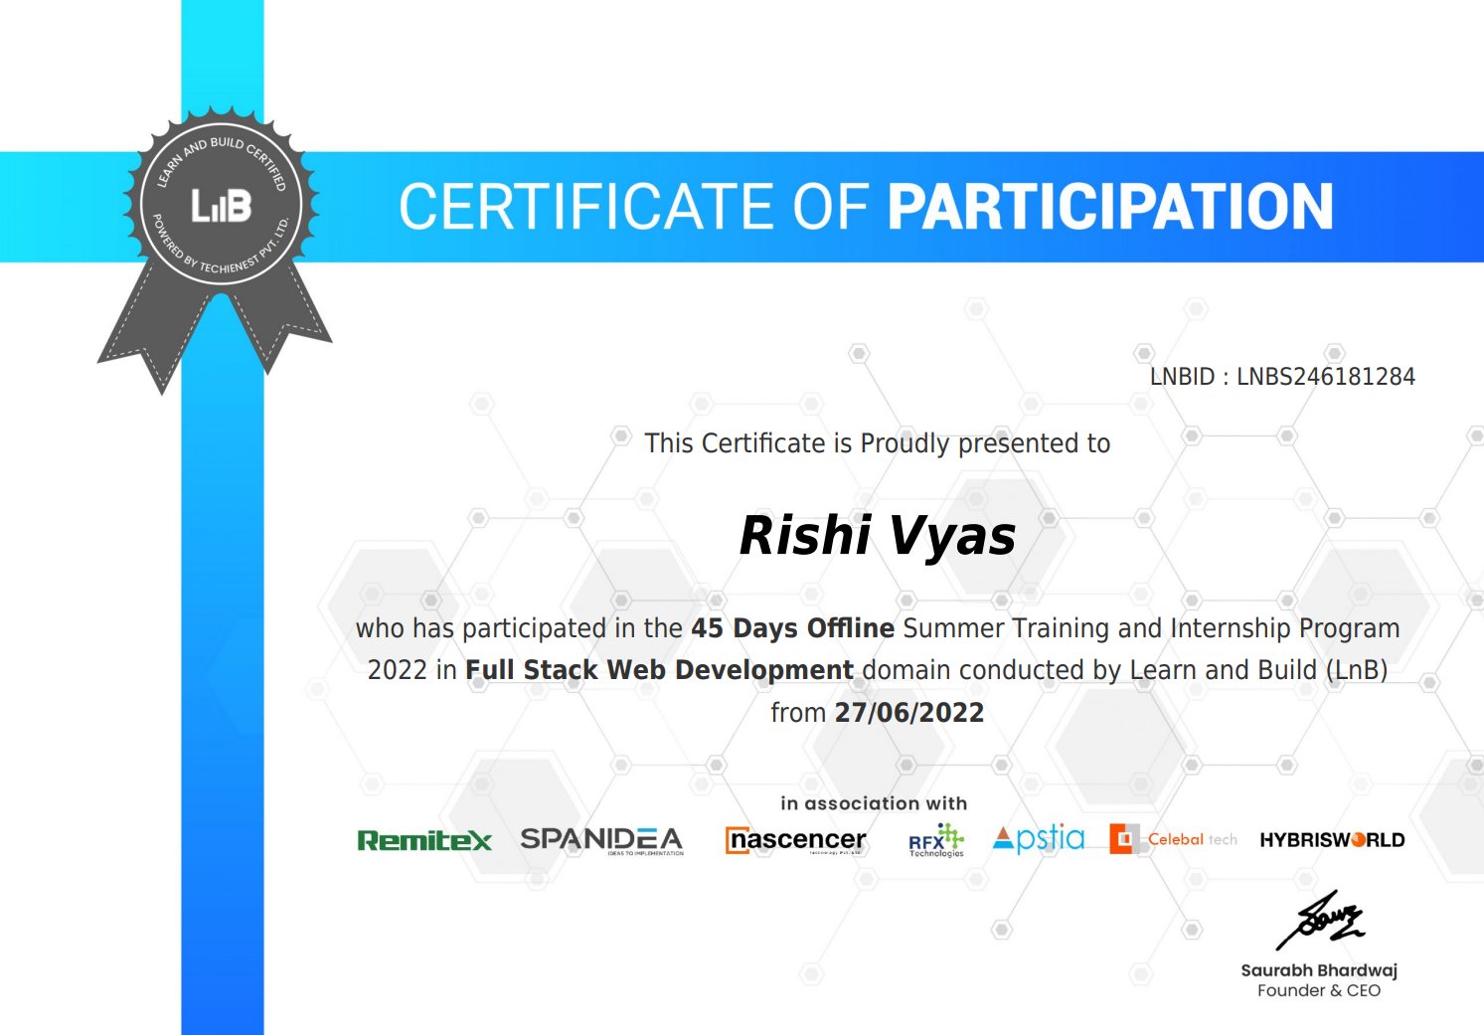
CERTIFICATE

Slide 8

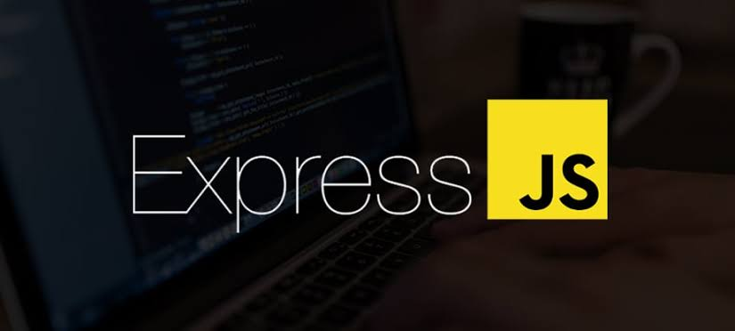

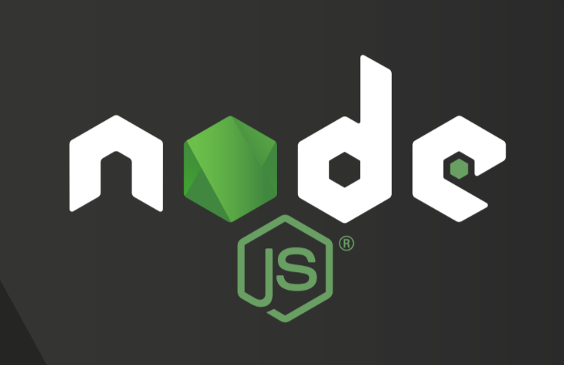
TECHNOLOGY NAME
The technologies used in this course are:-
1.MongoDB
2.ExpressJS
3.ReactJS
4.NodeJS

Slide 9

MongoDB
MongoDB is a NoSQL database where each record is a document comprising of key-value pairs that are similar to JSON (JavaScript Object Notation) objects. MongoDB is flexible and allows its users to create schema, databases, tables, etc. Documents that are identifiable by a primary key make up the basic unit of MongoDB. Once MongoDB is installed, users can make use of Mongo shell as well. Mongo shell provides a JavaScript interface through which the users can interact and carry out operations (eg: querying, updating records, deleting records).

Slide 10
Why use MongoDB?
Fast – Being a document-oriented database, easy to index documents. Therefore a faster response.
Scalability – Large data can be handled by dividing it into several machines.
Use of JavaScript – MongoDB uses JavaScript which is the biggest advantage.
Schema Less – Any type of data in a separate document.
Data stored in the form of JSON –
Objects, Object Members, Arrays, Values, and Strings
JSON syntax is very easy to use.
JSON has a wide range of browser compatibility.
Sharing Data: Data of any size and type(video, audio) can be shared easily.
Simple Environment Setup – Its really simple to set up MongoDB.
Flexible Document Model – MongoDB supports document-model(tables, schemas, columns & SQL) which is faster and easier.

Slide 11
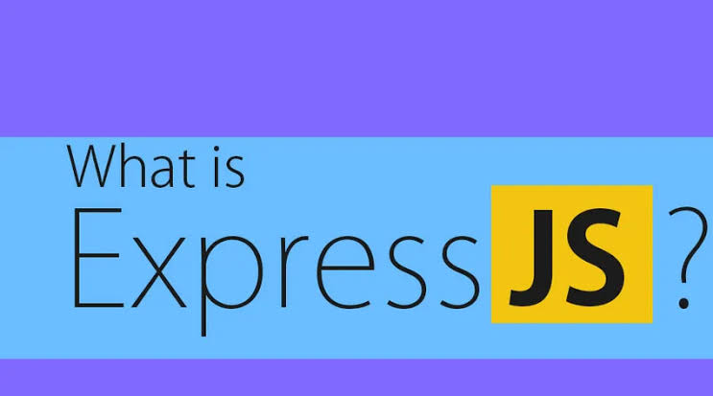
ExpressJS
Express is a Node.js framework. Rather than writing the code using Node.js and creating loads of Node modules, Express makes it simpler and easier to write the back-end code. Express helps in designing great web applications and APIs. Express supports many middlewares which makes the code shorter and easier to write.

Slide 12
Why use Express?
Asynchronous and Single-threaded.
Efficient, fast & scalable
Has the biggest community for Node.js
Express promotes code reusability with its built-in router.
Robust API
Create a new folder to start your express project and type below command in the command prompt to initialize a package.json file. Accept the default settings and continue.
.

Slide 13

ReactJS
React is a JavaScript library that is used for building user interfaces. React is used for the development of single-page applications and mobile applications because of its ability to handle rapidly changing data. React allows users to code in JavaScript and create UI components.

Slide 14
Why use React?
Virtual DOM – A virtual DOM object is a representation of a DOM object. Virtual DOM is actually a copy of the original DOM. Any modification in the web application causes the entire UI to re-render the virtual DOM. Then the difference between the original DOM and this virtual DOM is compared and the changes are made accordingly to the original DOM.
JSX – Stands for JavaScript XML. It is an HTML/XML JavaScript Extension which is used in React. Makes it easier and simpler to write React components.
Components – ReactJS supports Components. Components are the building blocks of UI wherein each component has a logic and contributes to the overall UI. These components also promote code reusability and make the overall web application easier to understand.
High Performance – Features like Virtual DOM, JSX and Components makes it much faster than the rest of the frameworks out there.
Developing Android/Ios Apps – With React Native you can easily code Android-based or IOS-Based apps with just the knowledge of JavaScript and ReactJS.

Slide 15
Advantages of React:
Easy to understand and easy to use: A good supply of documentation, tutorials, and training resources, helps the developers to learn and to understand React Js easily. Especially for the developers with the JavaScript background, it is quite easy to use.
Easy Creation of the Dynamic Web Applications: Unlike the complex coding of a dynamic web application, React JS provides less coding and gives more functionality, and also supports the building of machine-readable codes.
Disadvantages of React:
The high pace of development: The high pace of development results in the continuous and fast environment changes so fast, which makes it hard to adopt all the. Thus the developers’ skills must always need to be updated along with the changes.
Poor Documentation: With a fast update and fast acceleration, proper documentation is not easy to make.
View Part: ReactJS only covers the UI Layers of the app and thus there is always a need to choose some other technologies for other development.

Slide 16
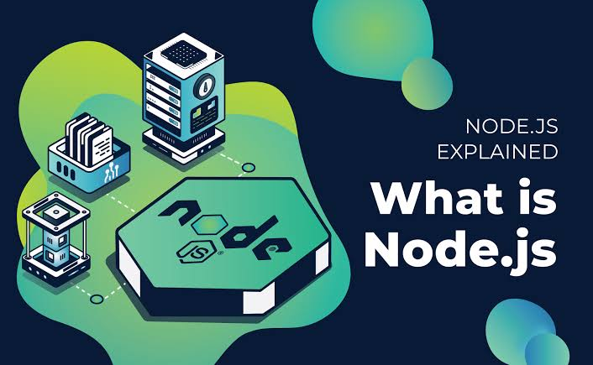
NodeJS
Node.js provides a JavaScript Environment which allows the user to run their code on the server (outside the browser). Node pack manager i.e. npm allows the user to choose from thousands of free packages (node modules) to download.

Slide 17
Why use Node.JS?
Open-source JavaScript Runtime Environment
Single threading – Follows a single-threaded model.
Data Streaming
Fast – Built on Google Chrome’s JavaScript Engine, Node.js has a fast code execution.
Highly Scalable
Initialize a Node.js application by typing running the below command in the command window. Accept the standard settings.

Slide 18




SOFTWARE/TOOLS USED
The list of software and tools I used for learning this course of web development are:
Sublime Text Editor 3
Github desktop application
Chrome browser
Node.js
Browser sync

Slide 19
SUBLIME TEXT 3
Sublime Text 3 (ST3) is a lightweight, cross-platform code editor known for its speed, ease of use, and strong community support. It's an incredible editor right out of the box, but the real power comes from the ability to enhance its functionality using Package Control and creating custom settings.
Two of the main features that Sublime Text 3 adds include symbol indexing and pane management. Symbol Indexing allows Sublime Text to scan files and build an index to facilitate the features Goto Definition and Goto Symbol in Project. Pane Management allows users to move between panes via hotkeys.

Slide 20
GITHUB DESKTOP
GitHub Desktop is a tool that allows you to interact with GitHub from the desktop. With this application, you can work easier without having to depend on your browser. GitHub Desktop supports: Attributing commits with collaborators.
GitHub Desktop is an application that enables you to interact with GitHub using a GUI instead of the command line or a web browser. GitHub Desktop encourages you and your team to collaborate using best practices with Git and GitHub. You can use GitHub Desktop to complete most Git commands from your desktop with visual confirmation of changes. You can push to, pull from, and clone remote repositories with GitHub Desktop, and use collaborative tools such as attributing commits and creating pull requests.

Slide 21
CHROME BROWSER
Google Chrome is a cross-platform web browser developed by Google. It was first released in 2008 for Microsoft Windows, built with free software components from Apple WebKit and Mozilla Firefox. It was later ported to Linux, macOS, iOS, and Android, where it is the default browser. The browser is also the main component of Chrome OS, where it serves as the platform for web applications.
Most of Chrome's source code comes from Google's free and open-source software project Chromium, but Chrome is licensed as proprietary freeware. WebKit was the original rendering engine, but Google eventually forked it to create the Blink engine; all Chrome variants except iOS now use Blink.

Slide 22
Node.js
Node.js is an open-source, cross-platform, back-end JavaScript runtime environment that runs on the V8 engine and executes JavaScript code outside a web browser. Node.js lets developers use JavaScript to write command line tools and for server-side scripting-running scripts server-side to produce dynamic web page content before the page is sent to the user's web browser. Consequently, Node.js represents a "JavaScript everywhere" paradigm, unifying web-application development around a single programming language, rather than different languages for server-side and client-side scripts.

Slide 23
BROWSER SYNC
Browser synchronization (often simply called sync) is a free cloud service provided by a web browser vendor for sharing settings and data across multiple installs. This is typically used to maintain a consistent browser setup on multiple devices. The user must be logged-in to their account to sync a browser.

Slide 24
DESCRIPTION
WEB DEVELOPMENT:
Web development is a broad term for the work involved in developing a website for the internet (world wide web) or an intranet ( a private network). Web development can range from developing the simple static single page of plain text to the most complex web-based internet applications, electronic businesses, and social network services.
Every website consists of two parts: front-end and back-end development.
The front-end is the part of the web that you can see and interact with.
While front-end code interacts with the user in real-time, the back-end interacts with a server to return user ready results.
The front-end is a combination of HTML, CSS and JavaScript coding.
The back-end is a combination of PHP, MySQL, etc.

Slide 25
Web development is the work involved in developing a website for the Internet (World Wide Web) or an intranet (a private network). Web development can range from developing a simple single static page of plain text to complex web applications, electronic businesses, and social network services. A more comprehensive list of tasks to which Web development commonly refers, may include Web engineering, Web design, Web content development, client liaison, client-side/server-side scripting, Web server and network security configuration, and e-commerce development.
Among Web professionals, "Web development" usually refers to the main non-design aspects of building Web sites: writing markup and coding. Web development may use content management systems (CMS) to make content changes easier and available with basic technical skills.

Slide 26
PROJECT DESCRIPTION
THE COMPLETE WEB DEVEOLPER IN 2022:ZERO TO MASTERY

Slide 27
1. Introduction to HTML5
-In this module we learnt the basics of HTML5. We started with instructional videos on how to set up your development environment, go over HTML5 basics like valid document structure, which elements can be included inside other elements and which can not, discussed the meaning and usefulness of HTML5 semantic tags, and went over essential HTML5 tags.
2. Introduction to CSS3
-A lot of people "tinker" with CSS. In this module, we went from the very basics of CSS3 to some fairly advanced concepts like floating and CSS rule conflict resolution. We went over the 'box model', background property, etc. We finally finished off the module with learning about Responsive Design using our own CSS code as well as started introduction of Twitter Bootstrap with its essential Grid System.

Slide 28
3. Coding the Restaurant Site
In this module ,we studied some basics about how to interact with a client when managing a web site project and then go visit a real client at their place of business (a Chinese restaurant), help the owner figure out what she wants in a site, and get acquainted with the restaurant in general. We spent the rest of the module building a real web site for this business from scratch.
4. Introduction to JavaScript
-What fun would a web site be if there was no functionality to it? In this module, we concentrated on learning the fundamentals of the JavaScript language. A lot of even seasoned developers “tinker” with JavaScript without really understanding how the language works. That leads to viewing the language as more of a nuisance instead of a powerful tool. That is why we discussed not only on the “how” but also on the “why”, so we were empowered by the JavaScript language features, not confused by them. This module covered just about everything - from common language constructs and JavaScript types to objects, functions, arrays, closures, and scope isolation.

Slide 29
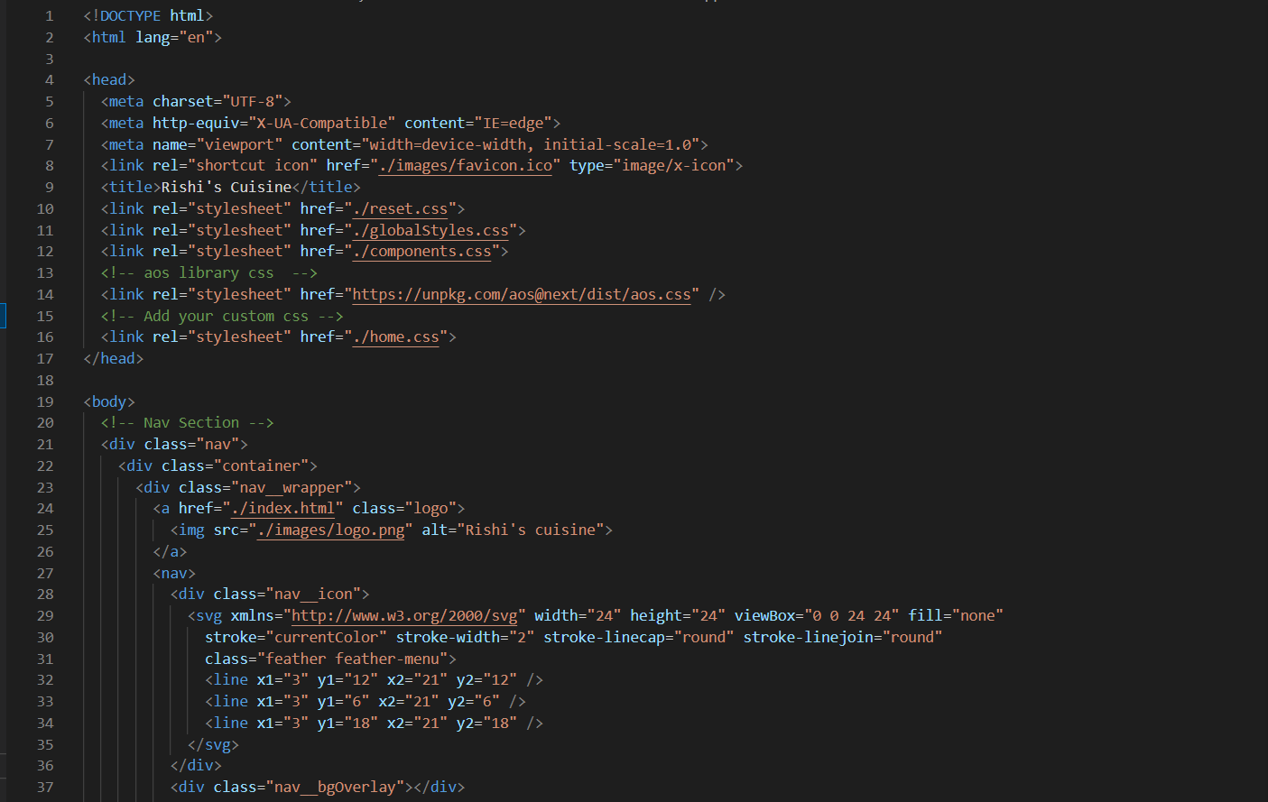
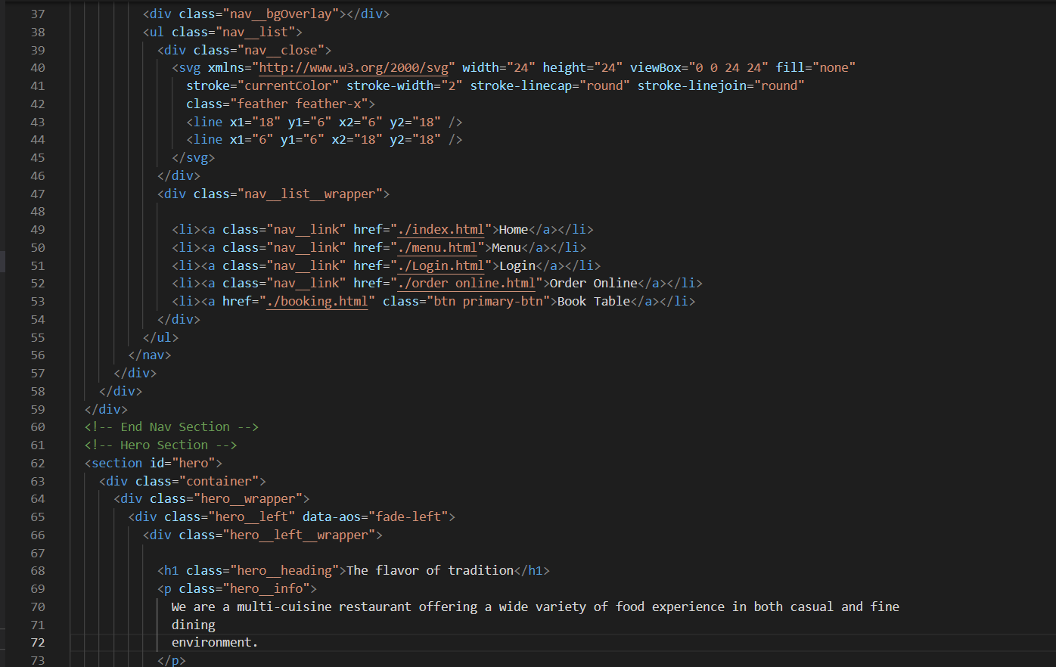
SCREENSHOTS
I was able to design a restaurant website with the help of my knowledge that I gained in this course.
Below are some snapshots of the website.

Slide 30
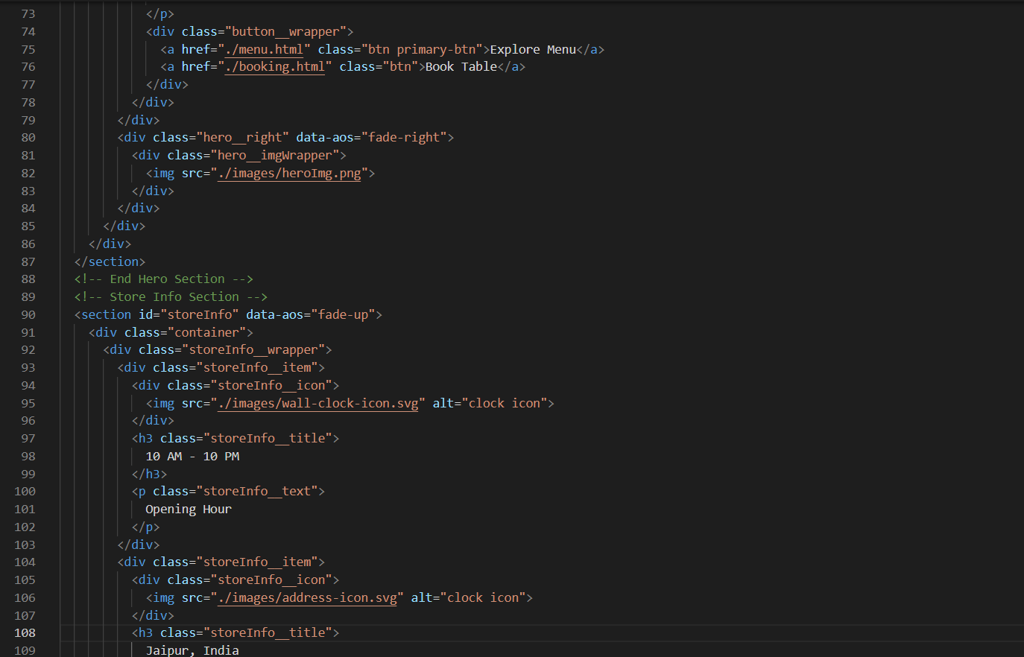
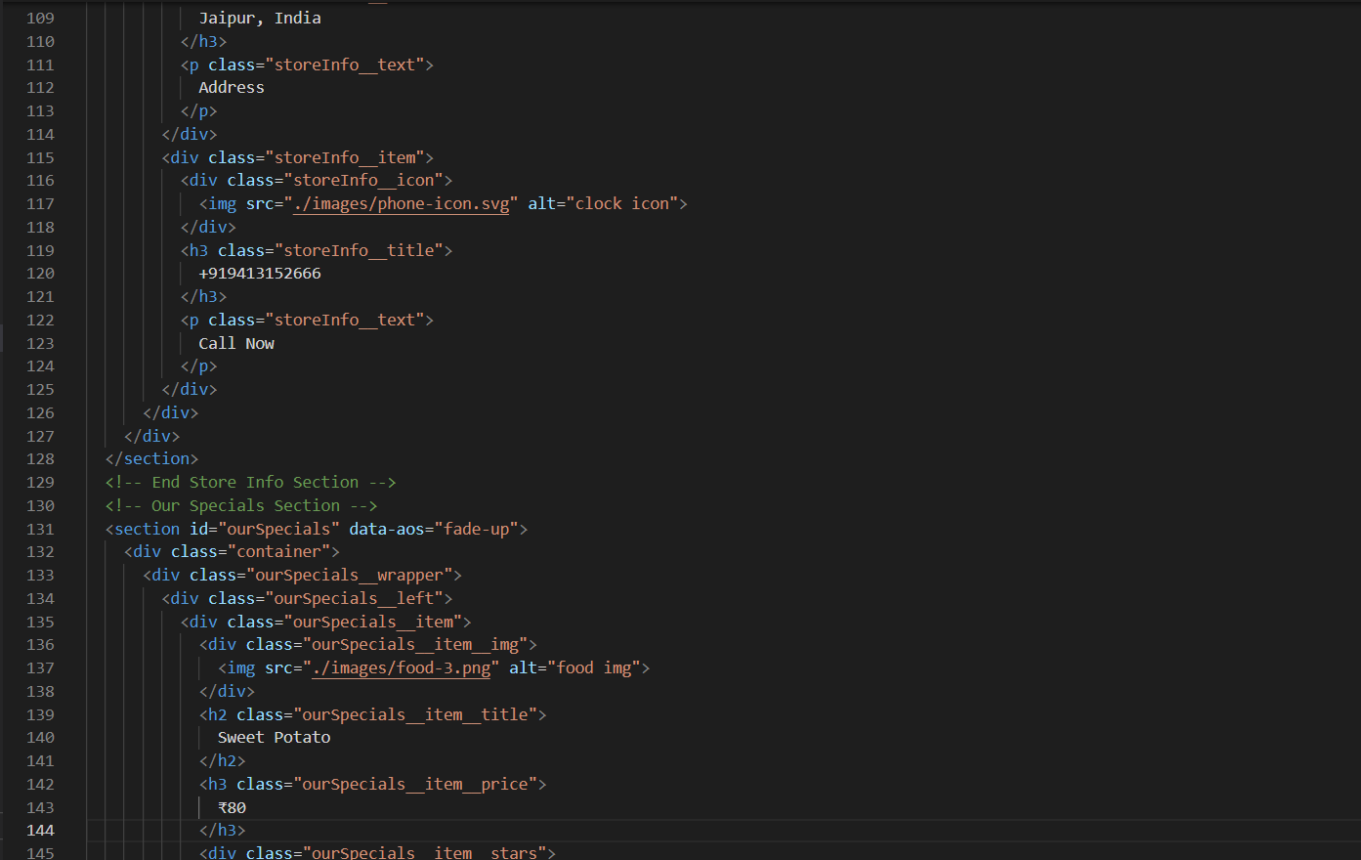

Slide 31
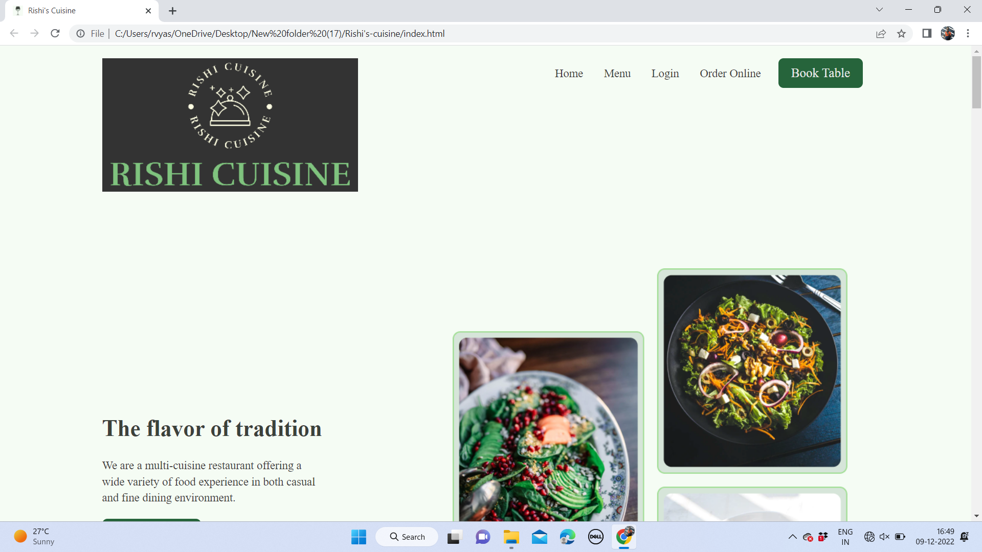

Slide 32
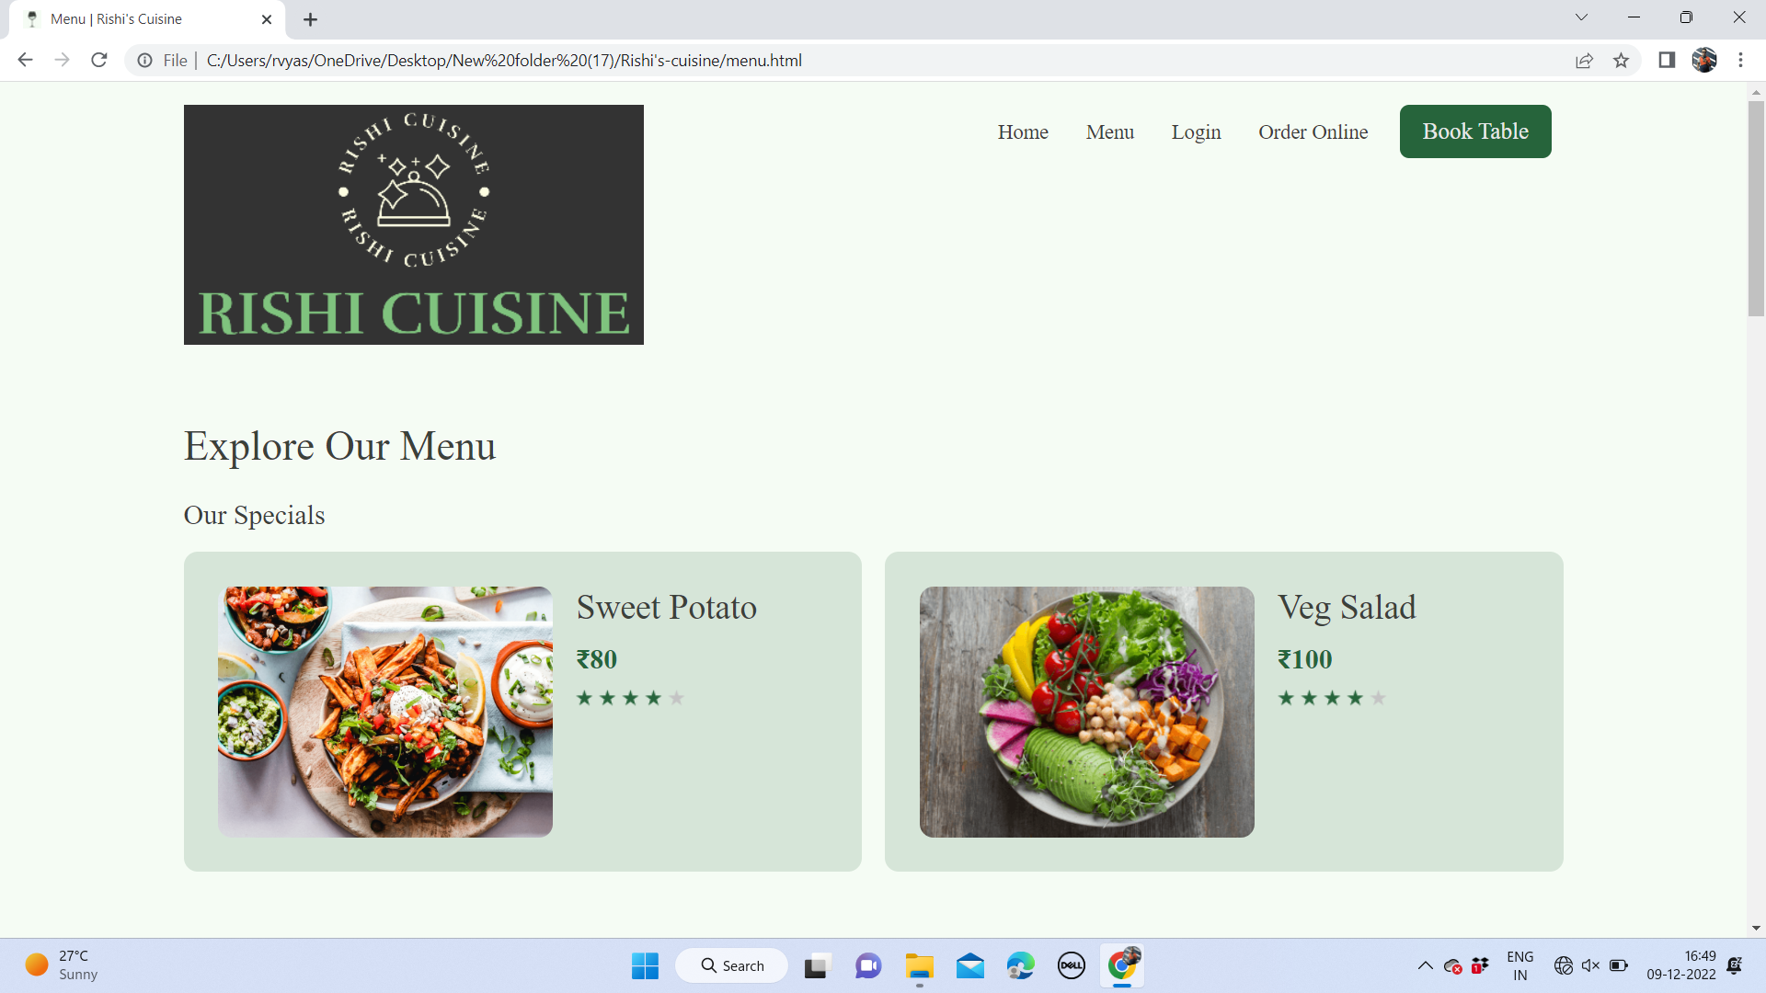

Slide 33
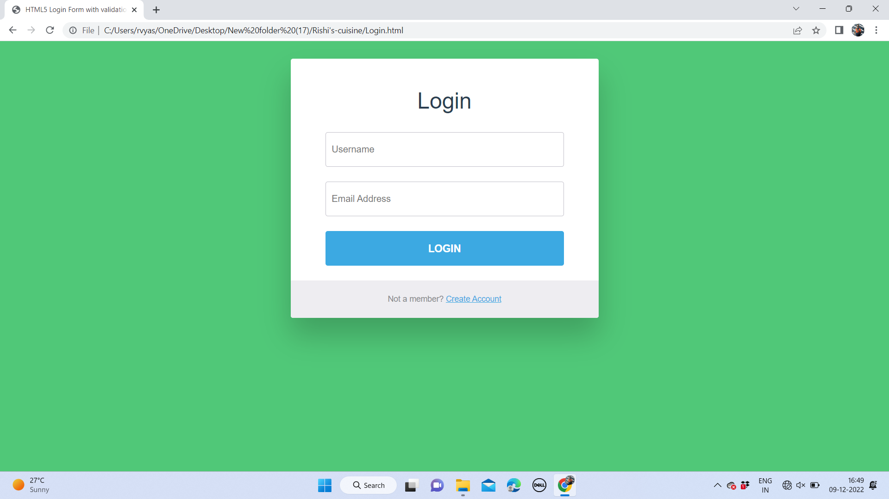

Slide 34
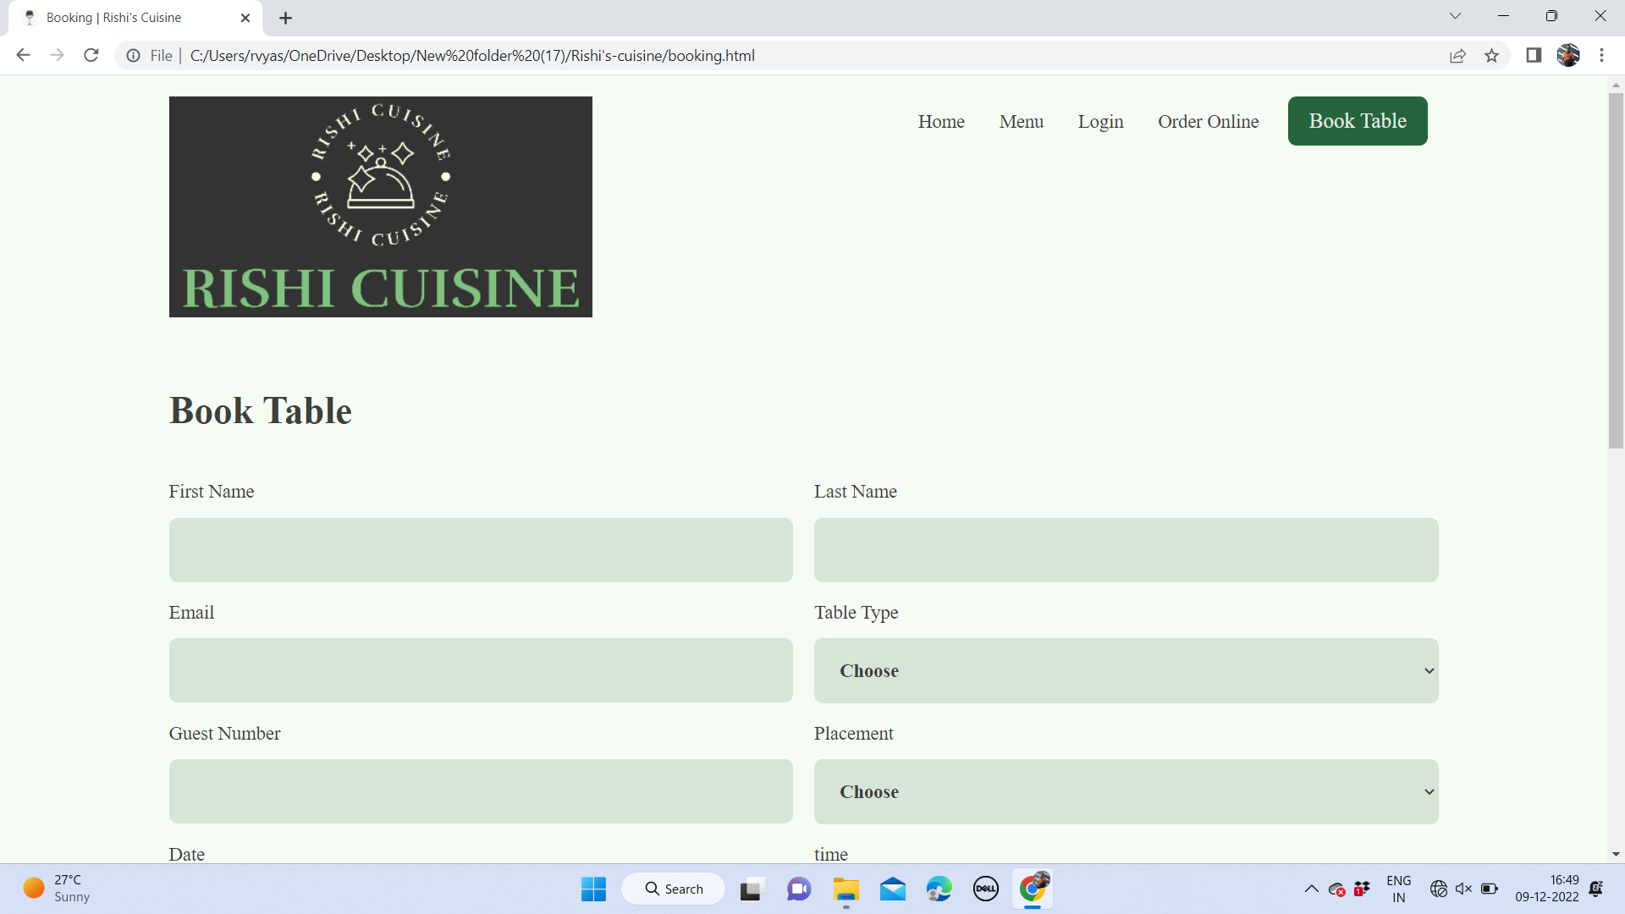

Slide 35
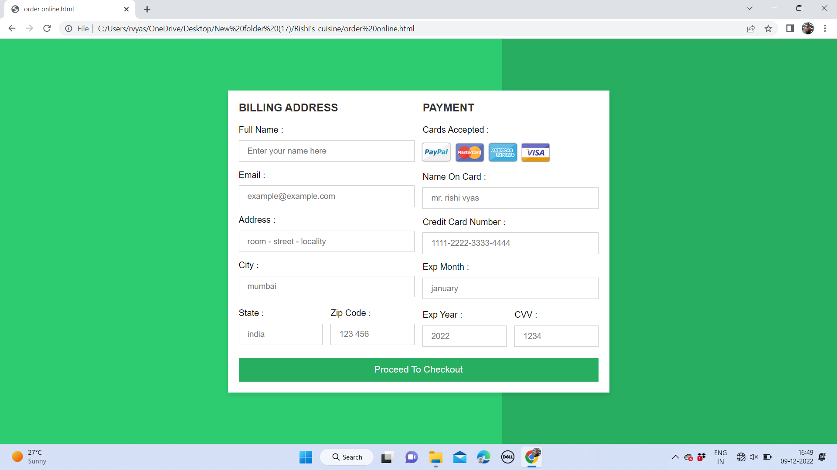

Slide 36
CONCLUSION
I have gained ample number of tips and tricks on programming and designing web pages and also learnt fundamentals of web development.
This training allowed me to widen my knowledge in HTML,CSS as having a very basic knowledge of it and also introduced me to JavaScript as it has a very interactive approach to web pages.
It also taught me time management and self motivating skills and I came across a variety of online learning platforms that offers a handful of knowledge at a very low price.

Slide 37
FUTURE SCOPE
A web developer is someone who turns designs into websites.
Being said that, the future of web development is nowhere in the dark, as every industry segment requires a website to take its products or services online, and web development plays an important role here.
Businesses around the globe are in constant search of professionals who can build outstanding websites for their online presence because the team of web developers and web designers can blend their technical skills and designing skills with all-new frameworks, tools, and advancements to create an attractive website for them.

Slide 38
REFERENCES
https://en.wikipedia.org/wiki/Sublime_Text
https://en.wikipedia.org/wiki/Bootstrap_(front-end_framework)
https://en.wikipedia.org/wiki/Udemy

Slide 39
THANK YOU

